Slide 1
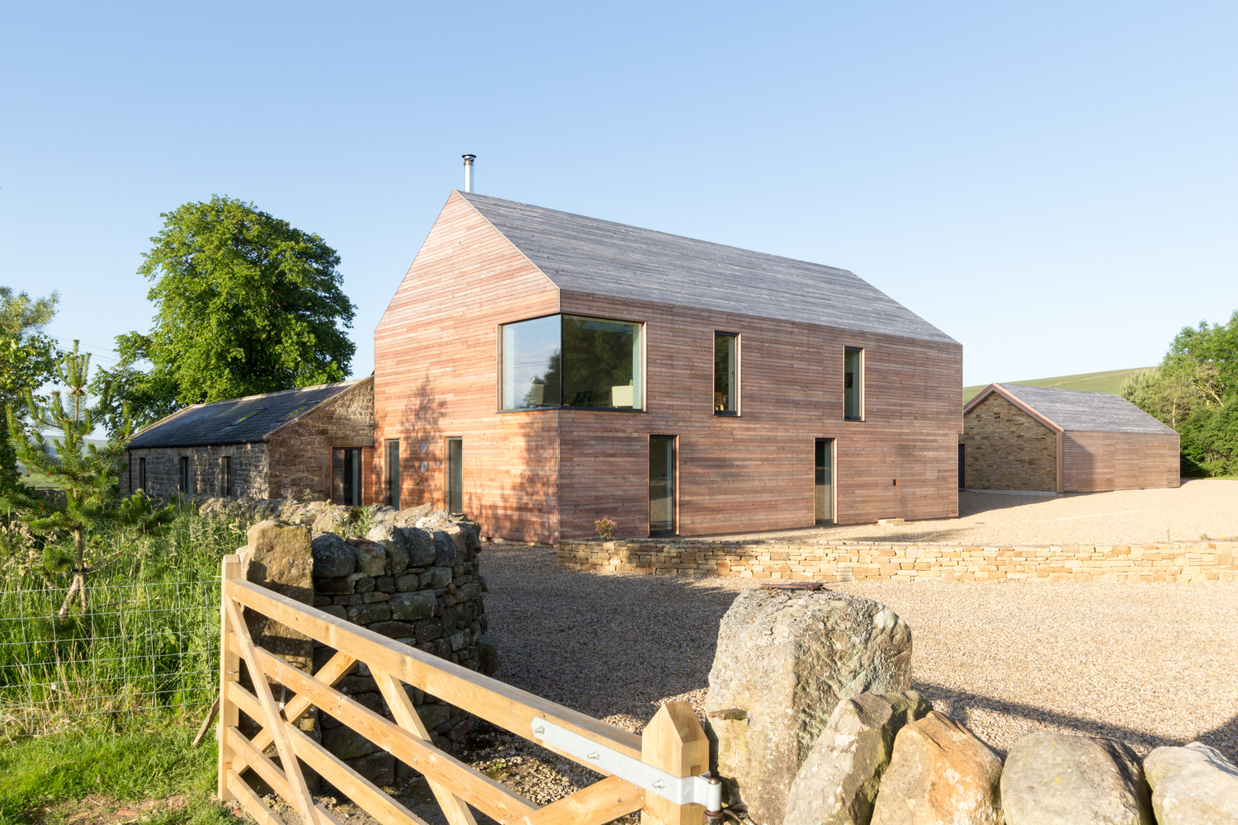
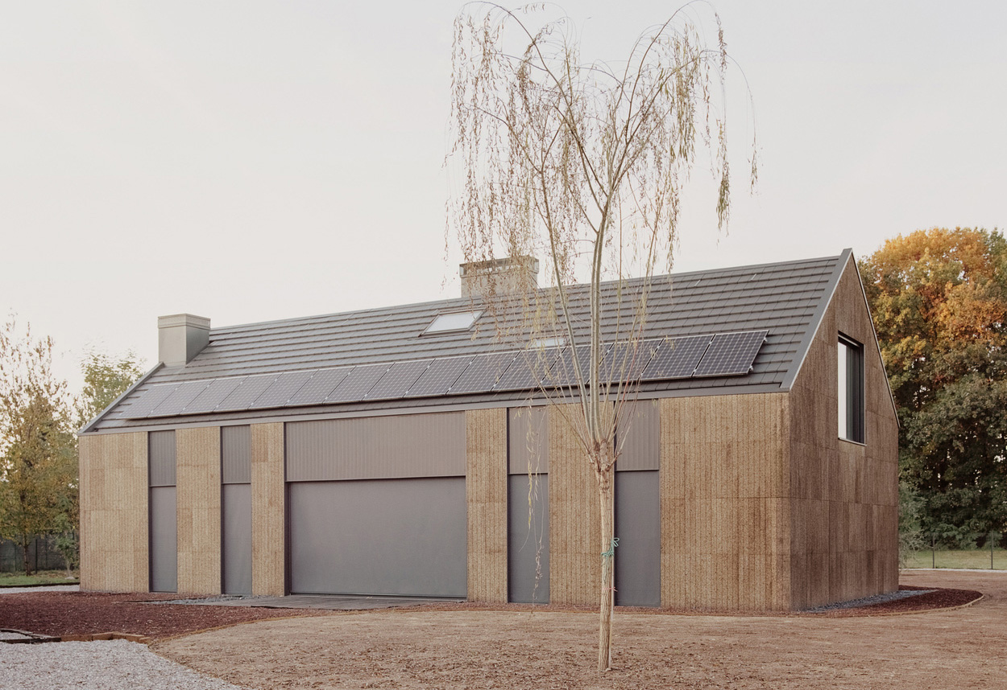
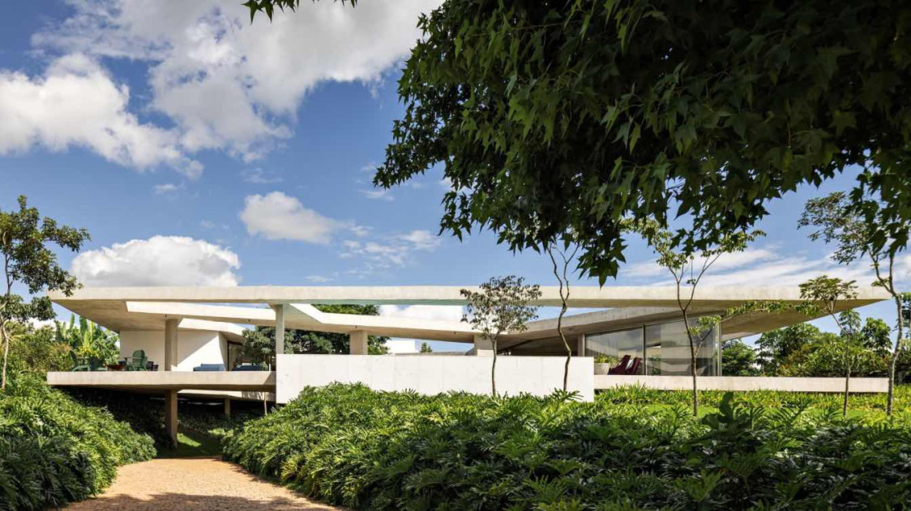
Sustainable Housing
United Kingdom - Shawm House
Italy – House of Wood, Straw & Cork
Brazil – Subtraction House
Group 7 – D. Martini (s8097697), D. Caputo (s4528393), P. Deep Singh (s8076712)

Slide 2



Theme Selection
Sustainable Housing has been chosen as the group theme to enable each team member to look closely at an example of international residential construction. Initially, the theme allowed our members to demonstrate how sustainable methodologies have been incorporated internationally in building industries, however it also enables our team to compare these to those currently adopted in the Australian building industry. As awareness and knowledge grow, it is of increasing importance that the building industry collectively learns from each other and works together to design sustainable homes for our health and the future health of the planet.

Slide 3
Sustainable Housing - UK
Shawm House
(D. Martini s8097697)
Architect: Mawson Kerr
Size: 274 m2 Completed: 2017

Slide 4
Shawm House - Reflection
Deemed by the local council to be in the open countryside, Shawm House is located in the rural area of West Woodburn, Northumberland, United Kingdom. The project consists of a new build and the incorporation of an existing stone stable and stone wall. The stone stable was a listed building.
Passivhaus principles have been employed and the result is a well designed, highly insulated and airtight home. Featuring triple glazed windows and doors throughout, quality insulation, rainwater storage, a mechanical heat recovery ventilation system and a solar photovoltaic system. Materials have been sourced locally, reducing transportation costs and greenhouse gas emissions. The home also incorporates a small elevator which serves to future-proof the build for the retired owners.
Incorporating an existing building into the new design demonstrates an important consideration to both sustainability and sustainable housing - to preserve, not waste, existing structures and to reimagine for future use. The considered design has saved the structure from ruin while also reducing land fill.

Slide 5

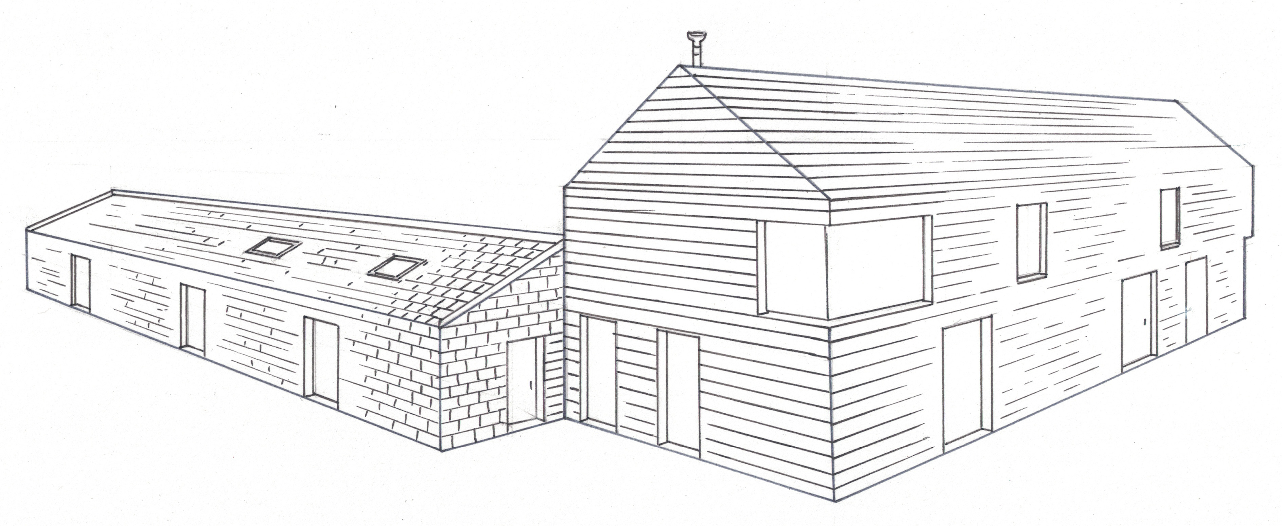

Shawm House – Hand Drawn External Perspective

Slide 6
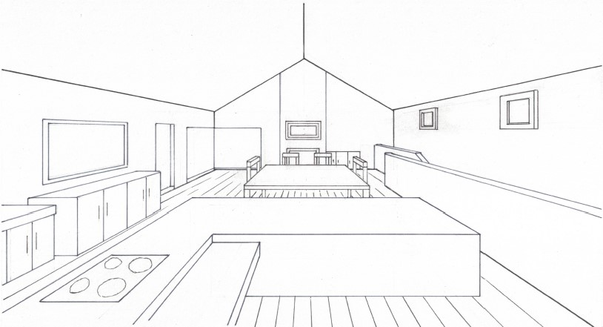

Shawm House – Hand Drawn Internal Perspective

Slide 7
Shawm House Site Analysis Diagram
In the following Site Analysis Diagram, the new build and existing buildings have been colour coded for quick identification. As indicated by the north direction arrow, in the new build two bedrooms on the ground floor, and the living areas and kitchen on the first floor, are on the north facing side. The glazing of these rooms makes use of natural daylight, minimising the need for artificial lighting. The kitchen has two west facing vertical windows and glazed doors however some protection is provided from the eave overhang and triple glazing. The stone stable has been reconfigured to house a bedroom, bathroom and lounge area. All feature glazing on the east side, while the lounge area also features a large south facing window.
The prevailing winter wind comes from the north-east, while the summer wind is from the south-west. The existing stone wall has been retained in the design and provides protection from prevailing winds.
Vehicular access routes are designed to provide access to each of the buildings on the site while also offering privacy to residents. The inclusion of stone gravel on the driveways enables stormwater to be absorbed, minimising run off.

Slide 8
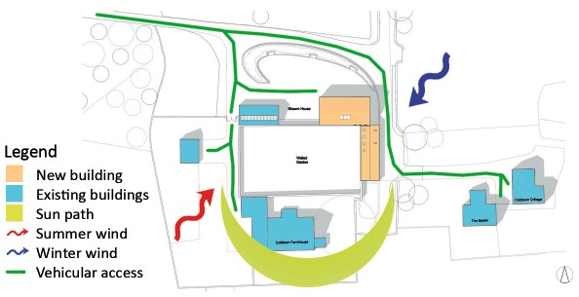

Slide 9
Shawm House Floor Plan Analysis Diagram
In the following Floor Plan Analysis Diagram, cross ventilation is provided by the well positioned windows and doors throughout and the openable skylight windows in the roof of the stone stable and upper windows on the first floor of the new build. Inclusion of the skylights and upper windows enables any rising heat in the build to be purged at night.
With the existing stone wall and the stone side of the stable, the build is protected from the prevailing winds and the occasional 30 deg Celsius high of summer, and 0 deg Celsius low of winter.
Access throughout the ground floor is via the hallway. Doors segregate the hallway into two parts, while the entry door to each room off the hallway provides privacy to each while also enabling noise control. Access to the first floor is via the staircase (or lift) and the open living area offers easy access to each room and the external balcony.
The majority of rooms in the new build and renovated stable face in the northern or eastern direction which affords each room a rural view and therefore overlooking the existing buildings on the site is avoided.

Slide 10
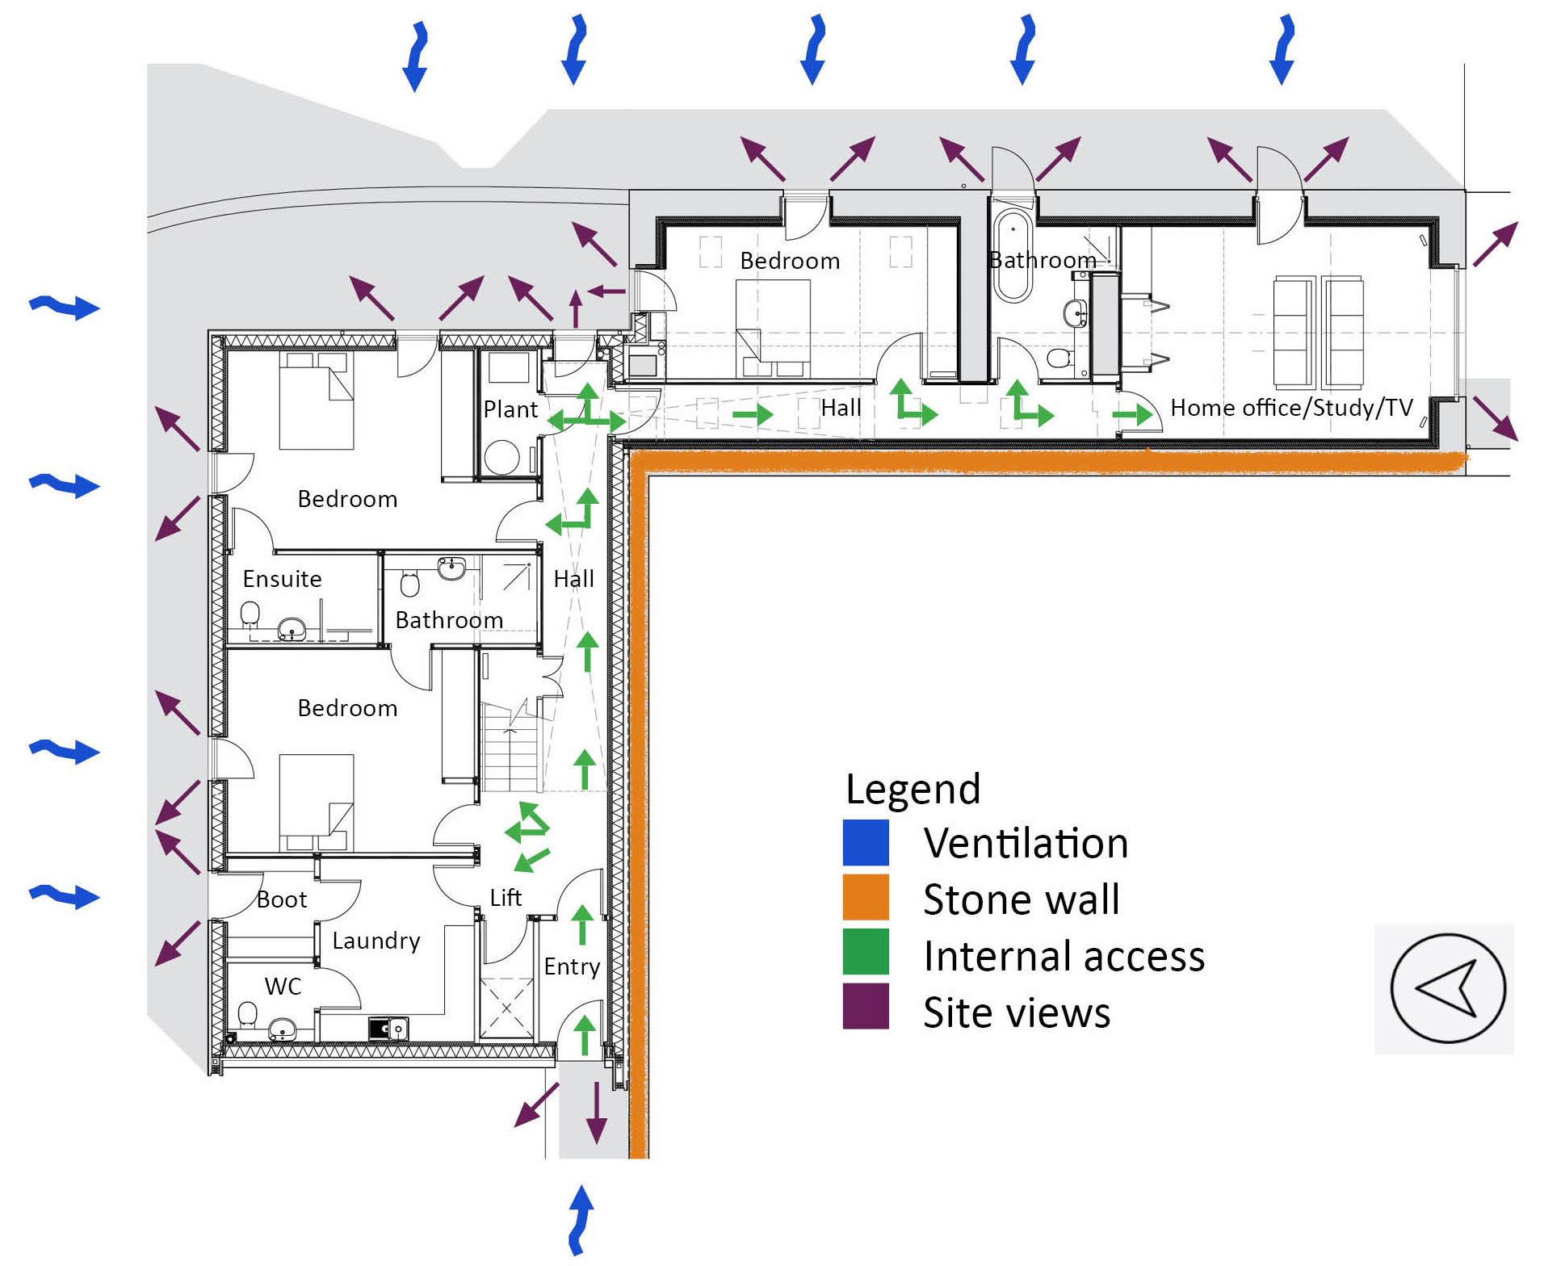

Slide 11
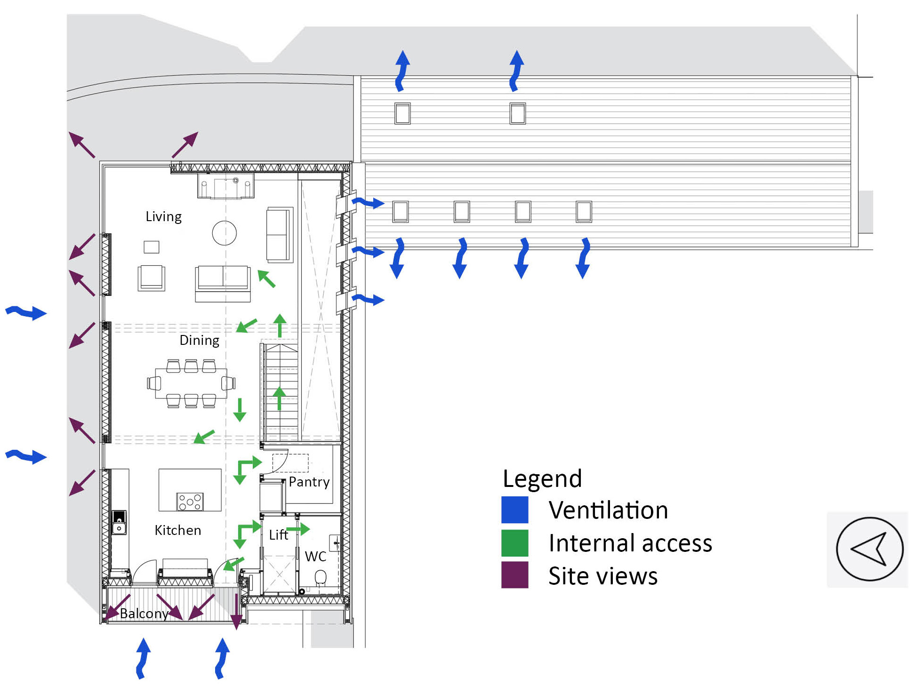

Slide 12
Shawm House - Model Making
Materials purchased
Tools
Balsa wood, 50 x 300 x 3mm
Balsa wood, 100 x 915 x 3mm
Balsa wood, 100 x 915 x 1mm
Match sticks
Cork, 300 x 400 x 3mm
Timber base
Opaque paper
Cutting mat, rulers, pencils, tweezers
Scalpel, stanley knife
uPVC glue, super glue, hot glue gun
Step 1 – prepare scaled floor plans and elevations (completed 5/4)
Step 2 – create wall, window and detail components from paper templates (completed 7/4)
Step 3 – getting parts and roof ready for assembly (due 11/4)
Step 4 – cut and assemble internal components (due 14/4)
Step 5 – prepare model for final presentation (due 16/4)

Slide 13
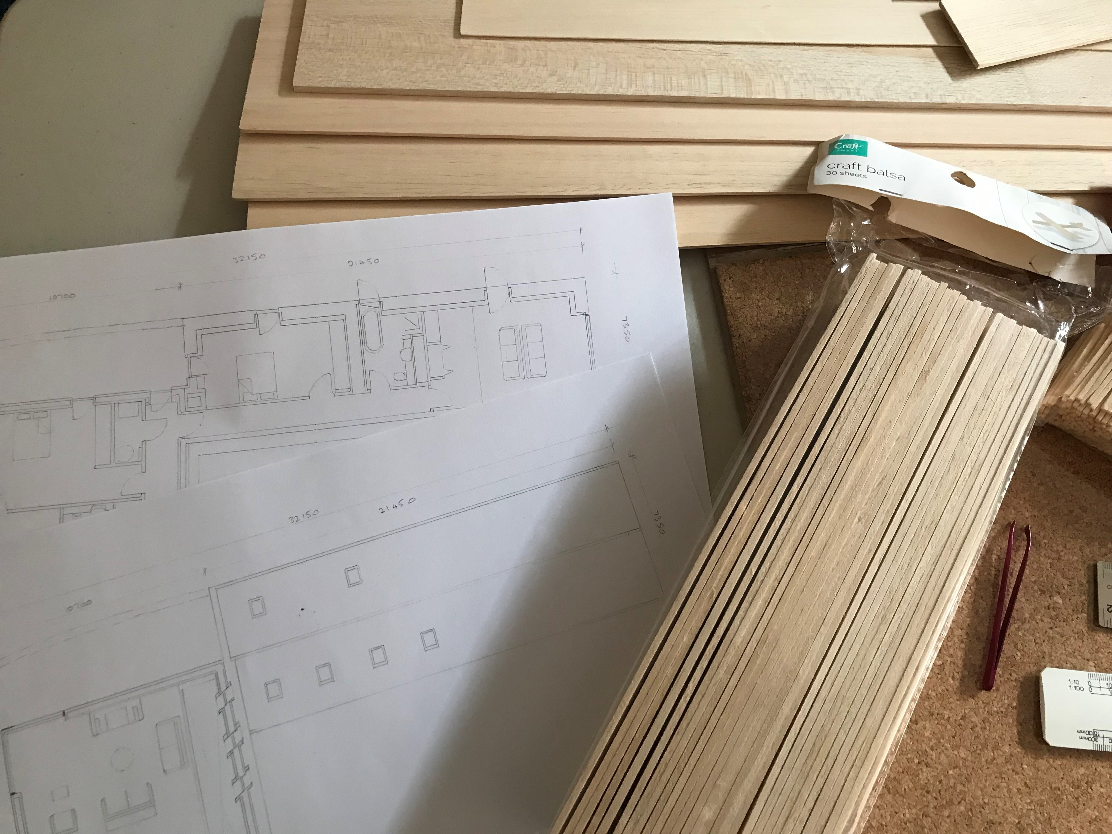
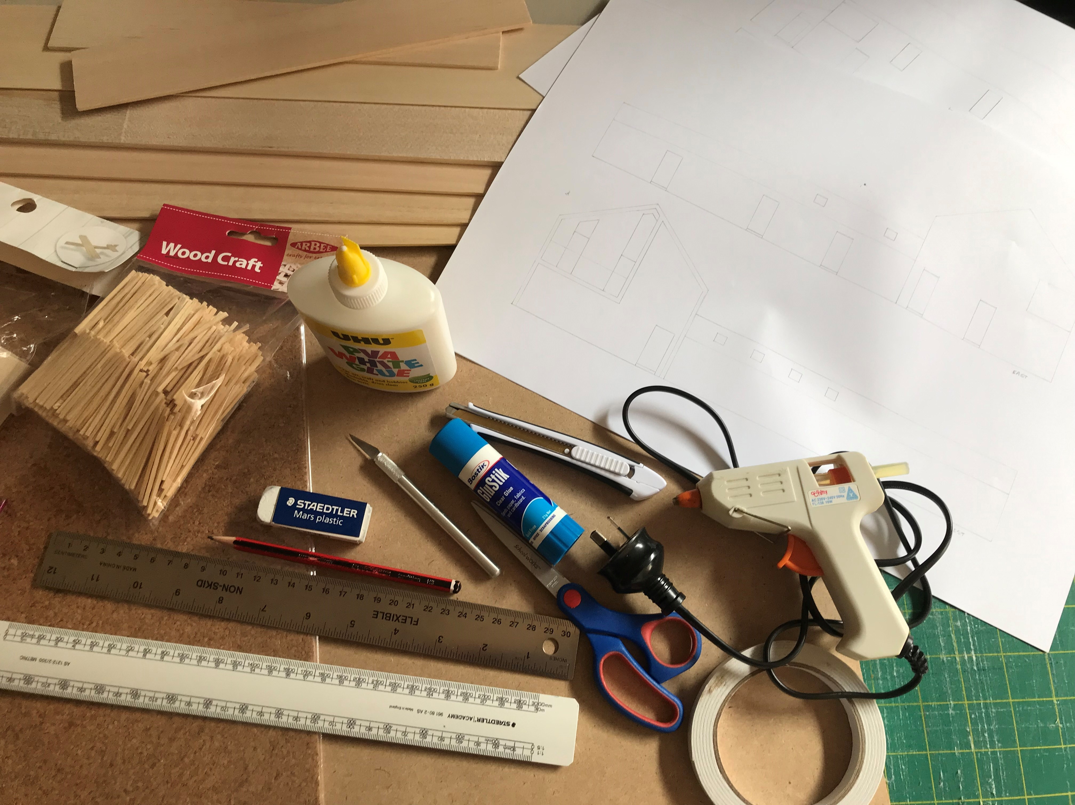
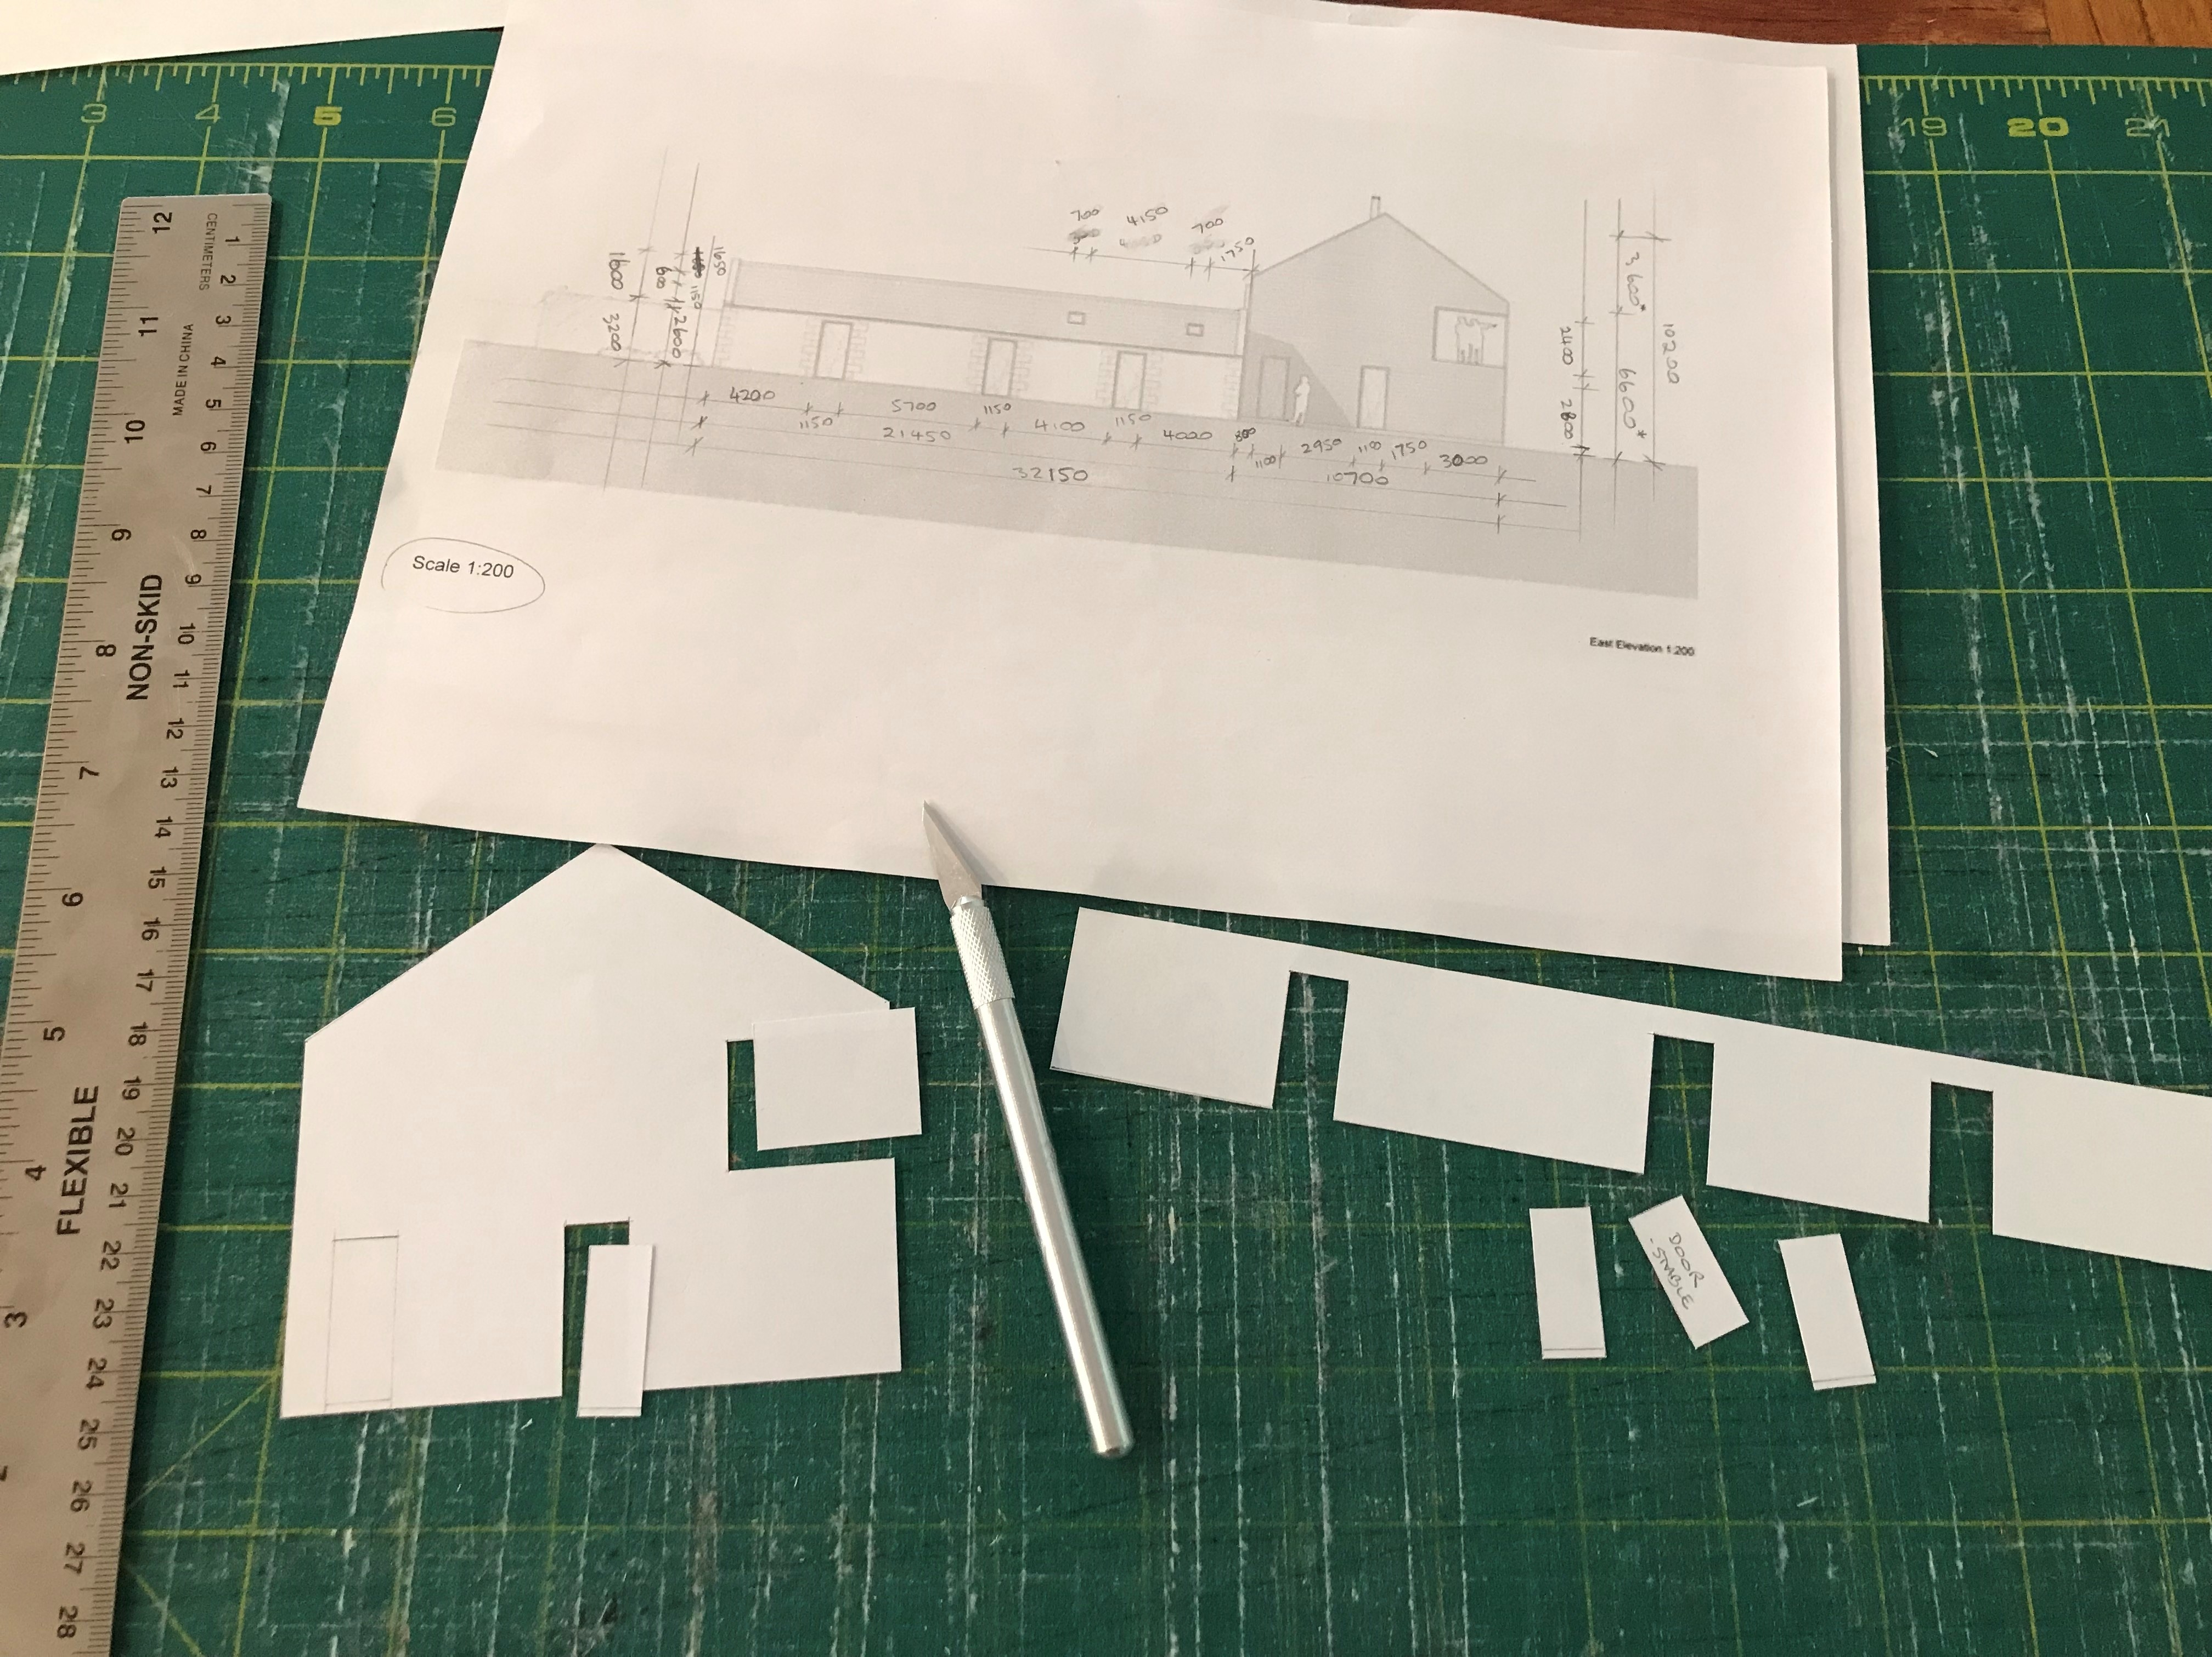
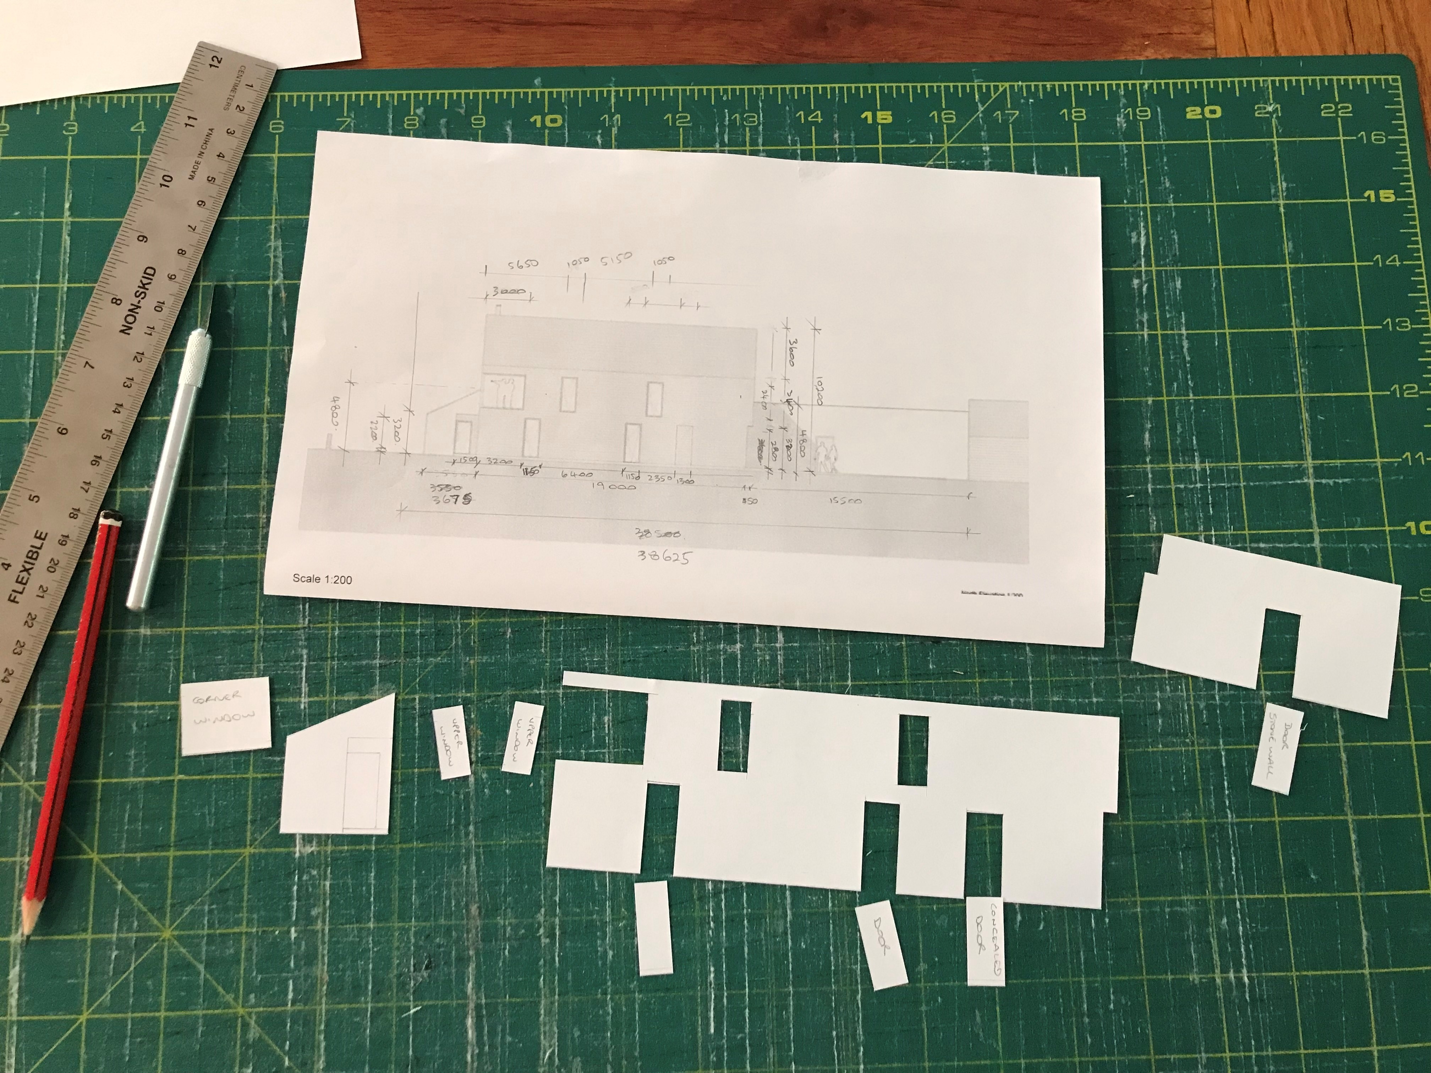
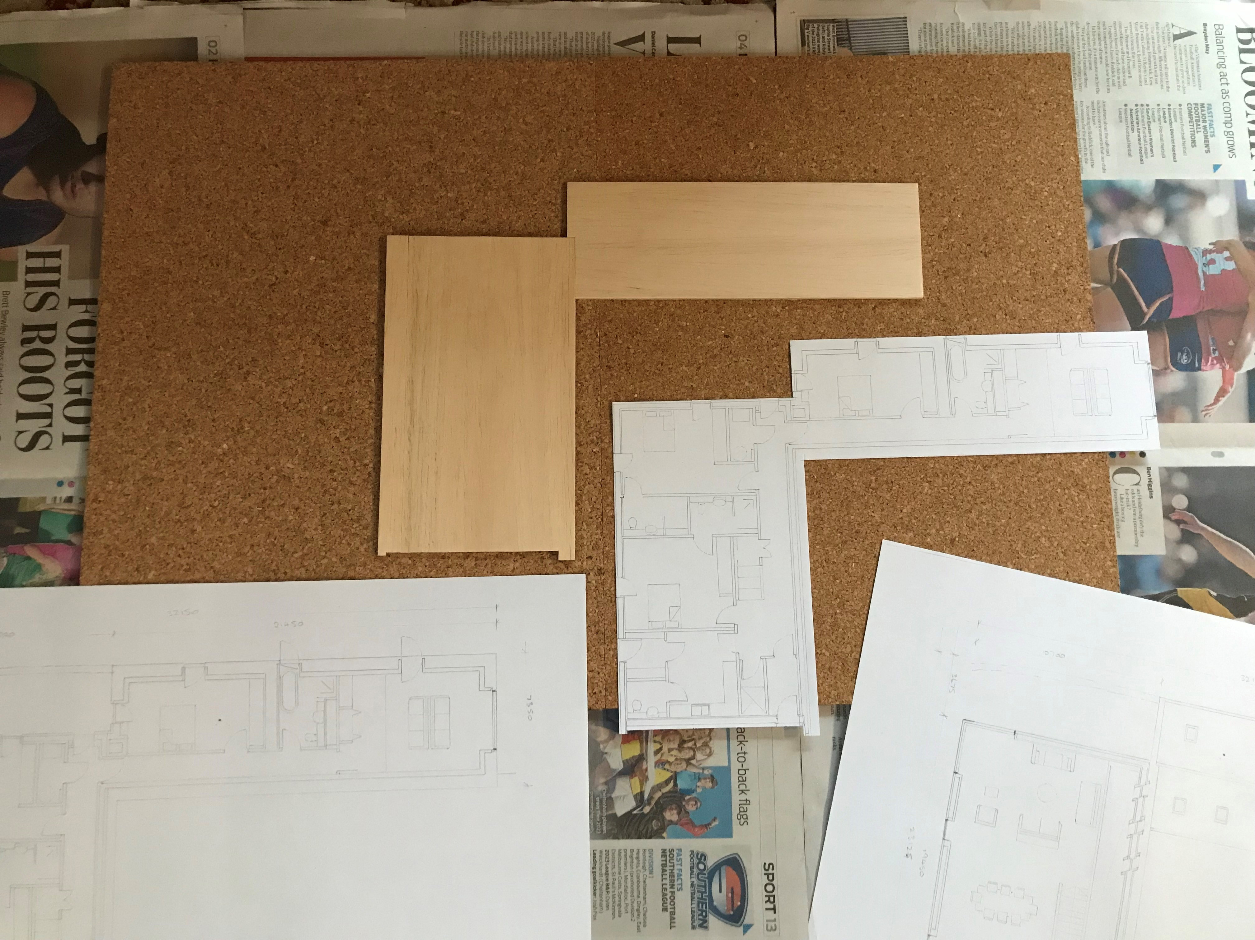
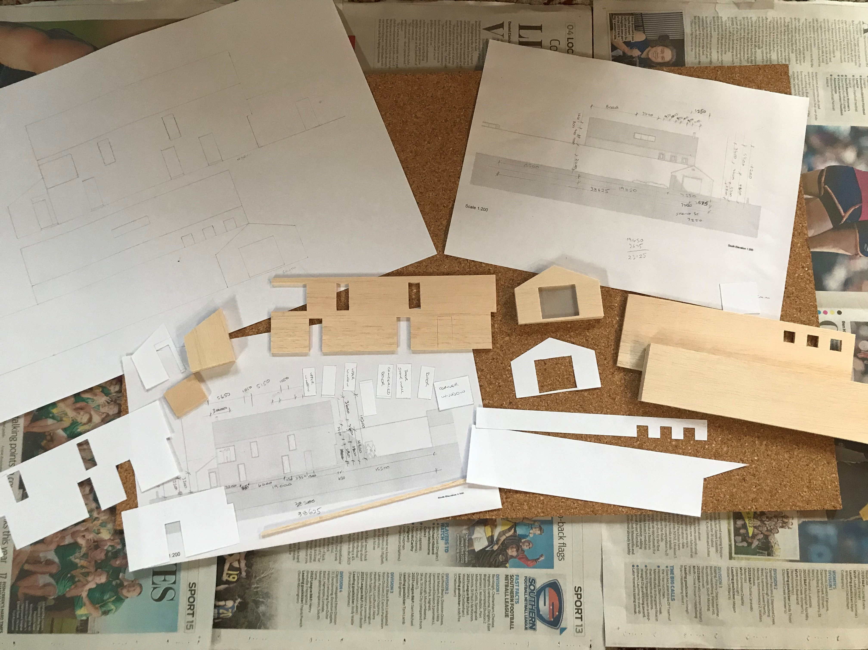
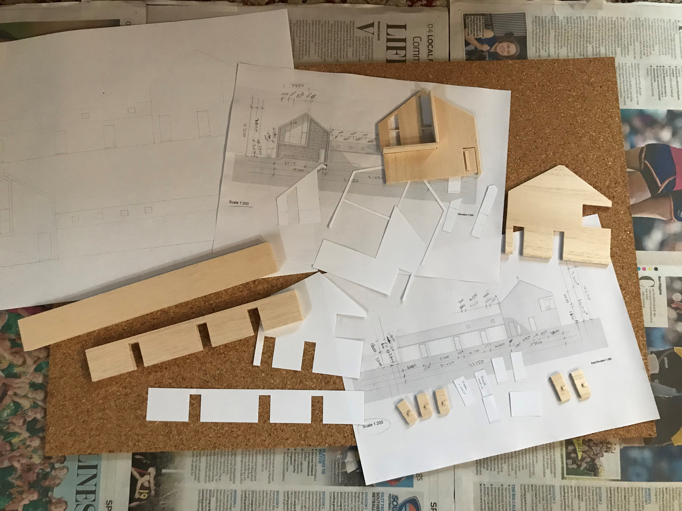
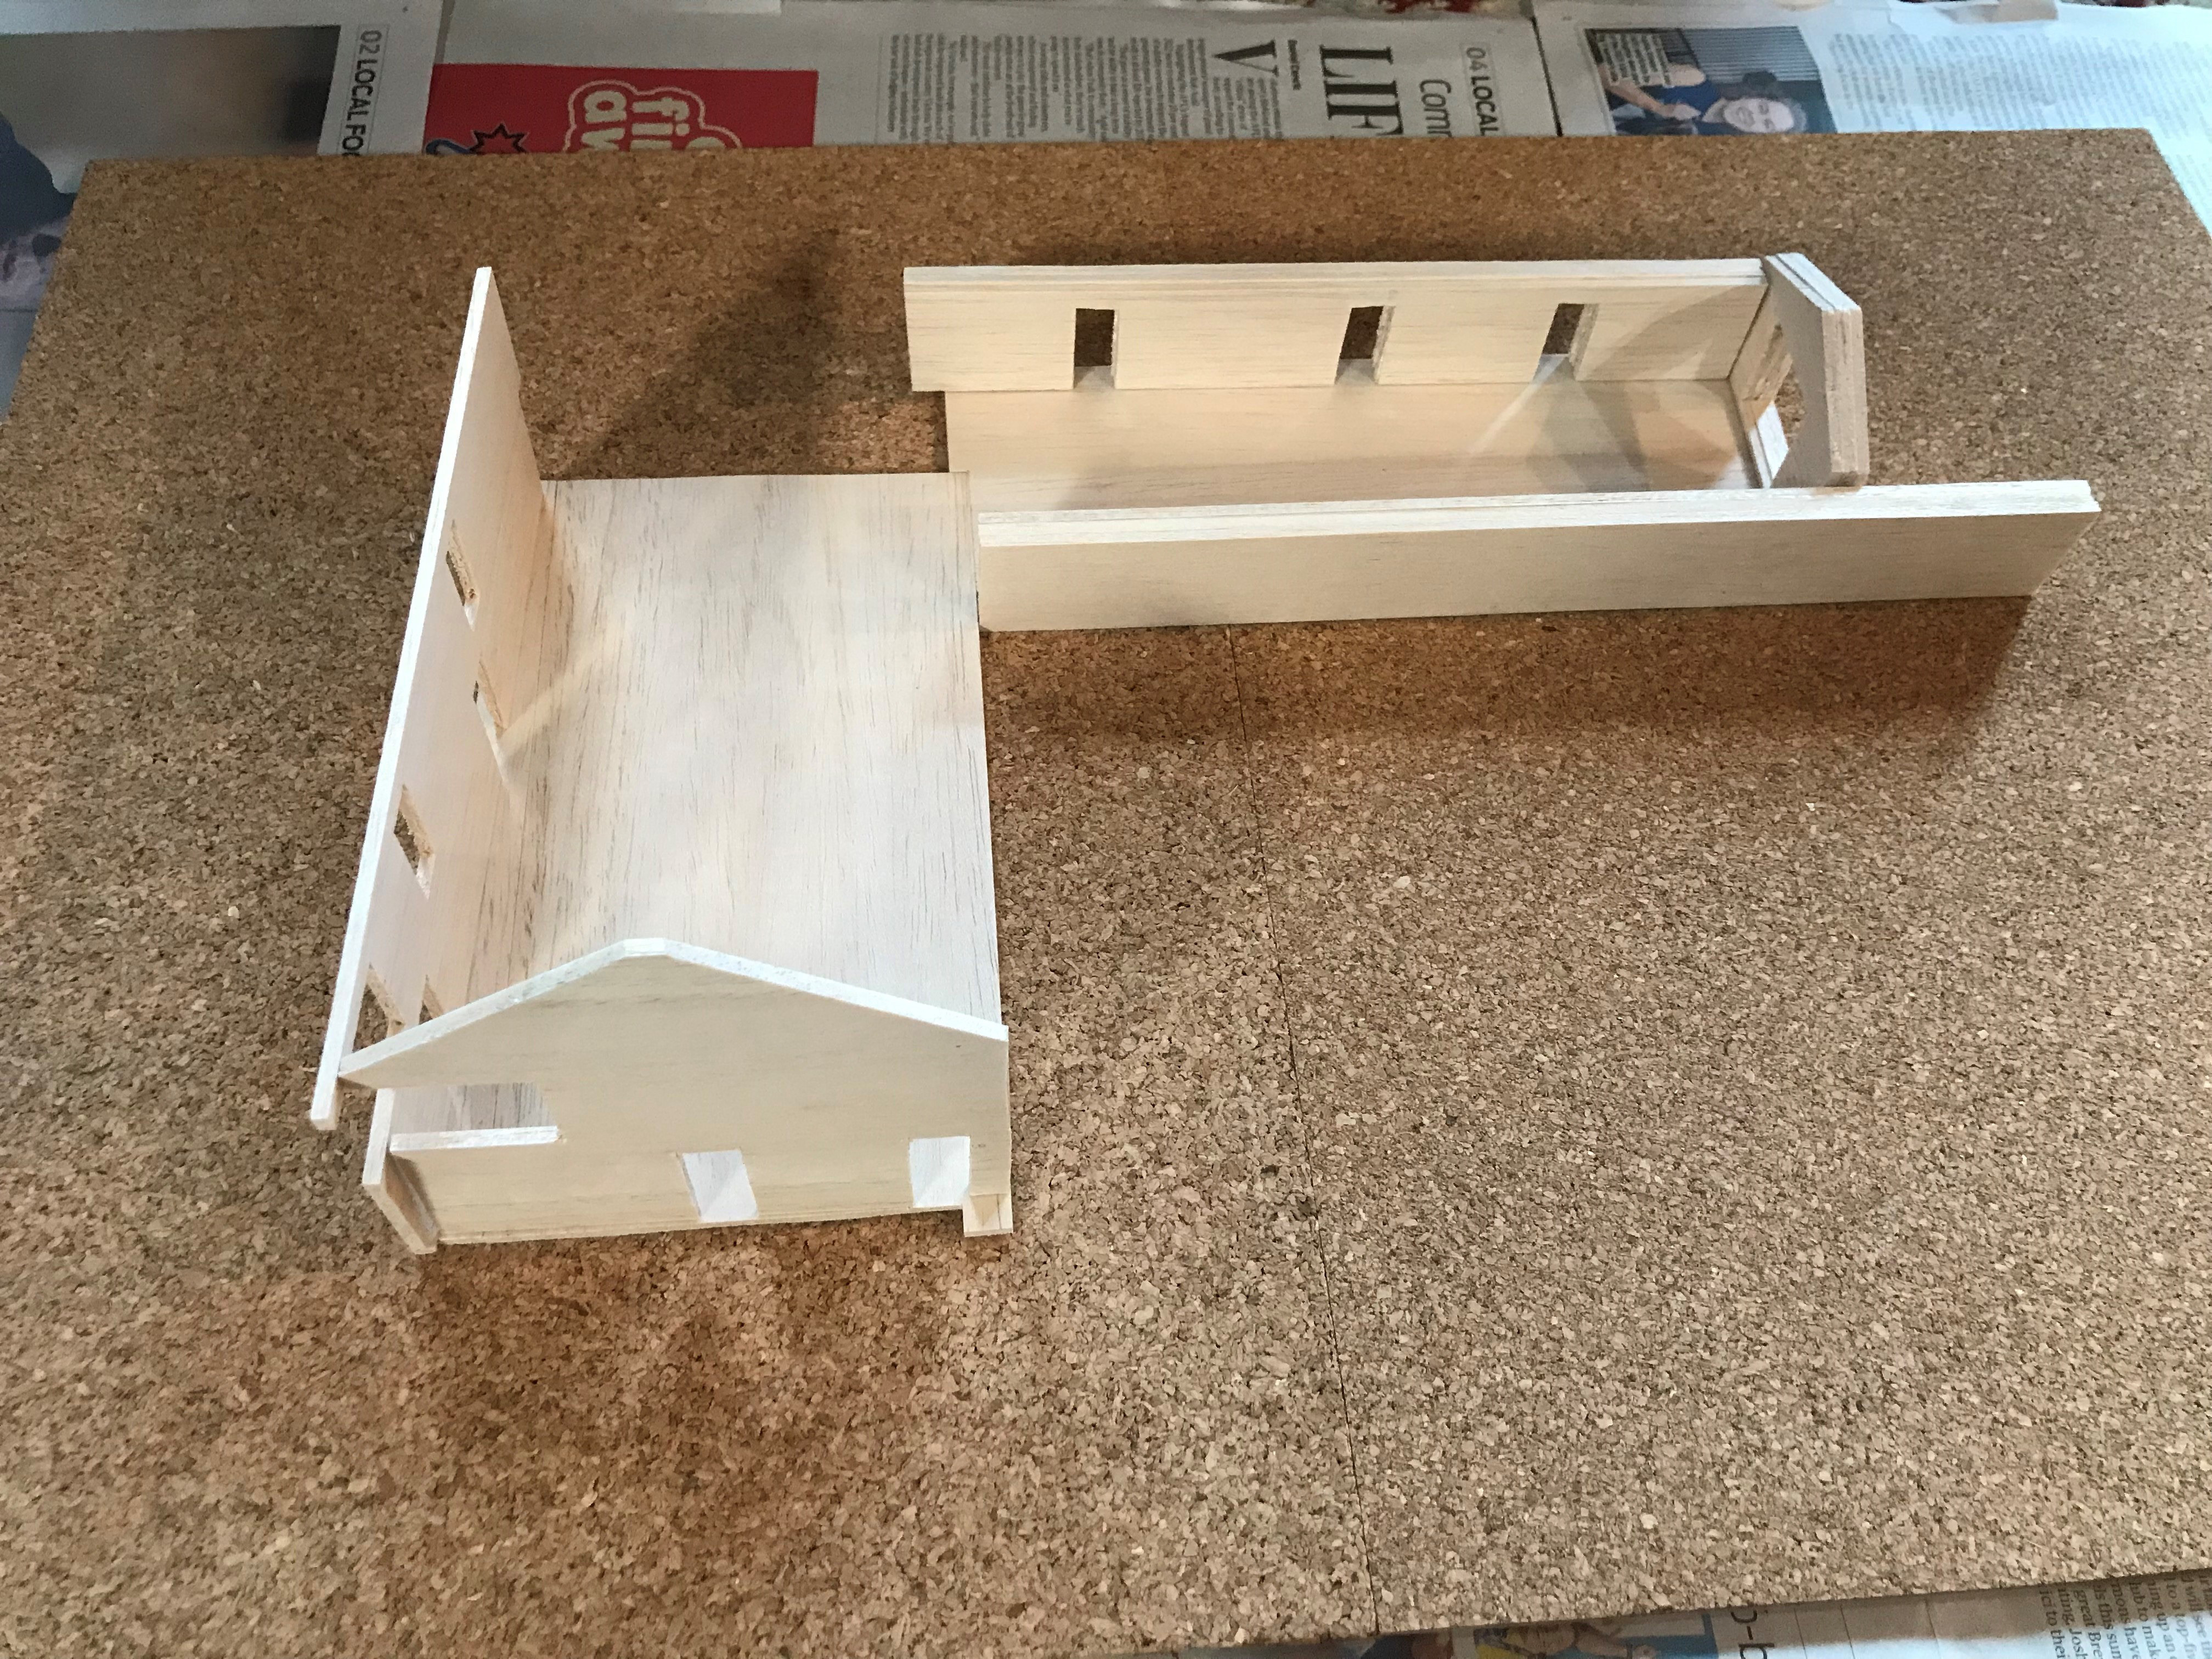
Shawm House – Model Making Progress
Materials and floor plans
Materials and elevation drawings
Cutting templates from drawings
Preparing templates
Preparing base and ground floor
Cutting out elevation pieces
Cutting out external walls and details
Getting parts ready for gluing

Slide 14
Group Poster Theme Style
Size – A1
Layout – portrait
Font – Garamond
Background – white with timber and nature images integrated
Order -
    Introduction, photo & reflection
    Perspective drawings
    Analysis diagrams & detailed information
    Progress and final images of model

